Slide 1


Quality Assurance
Bennet Hörmann, Salomo Hummel, Simeon Schrape, Erik Wu, Udo Zucker

Slide 2
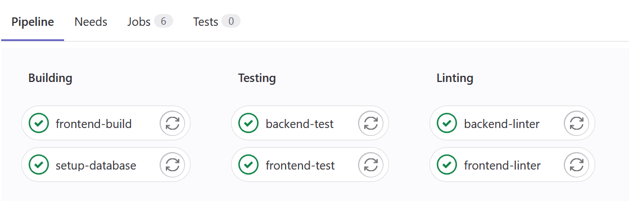
CI / CD Pipeline

Slide 3
CI / CD Pipeline – Unit Testing
Frontend: Jest
Backend: Unittest with Coverage

Slide 4
CI / CD Pipeline – Linting
Frontend: Eslint
Backend: Flake

Slide 5
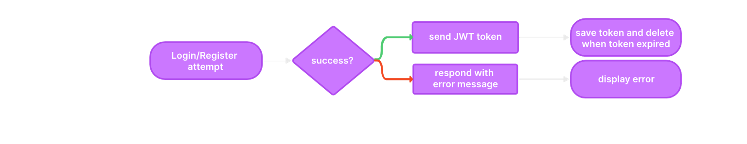
Problem when authentication token expires
Authentication implemented using JWT tokens

Slide 6
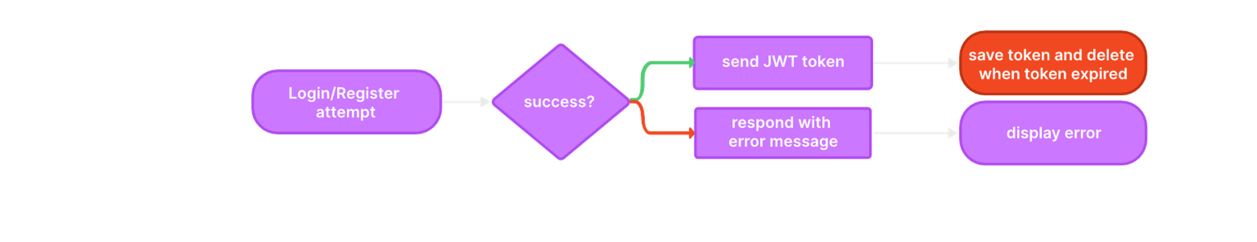
Problem when authentication token expires
Authentication implemented using JWT tokens

Slide 7
Problem when authentication token expires
Situation Token expires whilst user on page requiring authentication

Slide 8
Problem when authentication token expires
Situation Token expires whilst user on page requiring authentication
Previously User remains on page, interactions have no effect

Slide 9
Problem when authentication token expires
Situation Token expires whilst user on page requiring authentication
Previously User remains on page, interactions have no effect
Improved and desired behaviour
Logs user out
Redirects user to login page

Slide 10
Changes made to password storage
Previously Password hashes (using SHA-256) stored in database

Slide 11
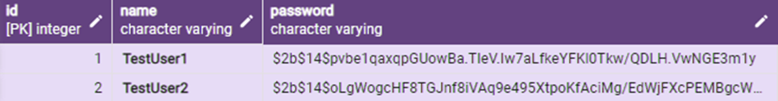
Changes made to password storage
Previously Password hashes (using SHA-256) stored in database
Improved
Passwords now hashed using bcrypt

Slide 12
Changes made to password storage
Previously Password hashes (using SHA-256) stored in database
Improved
Passwords now hashed using bcrypt
Password now also salted

Slide 13
Changes made to password storage
Previously Password hashes (using SHA-256) stored in database
Improved
Passwords now hashed using bcrypt
Password now also salted
Increased security

Slide 14
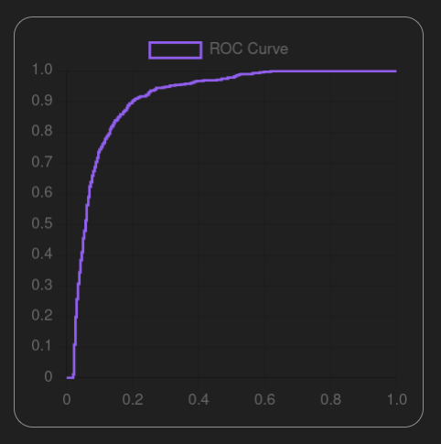
AUC and ROC Curve

Slide 15
Improved Subspace Logic
Previously
[0] or [1] or [2] and [3]
[0] or ([1] or ([2] and [3]))
Improved
([0] or [1]) and ([2] or [3])
Interpreted as

Slide 16
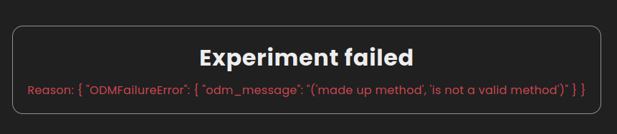
Improved ODM Error Handling
Previously Exceptions are not handled correctly
Improved Exceptions are handled and errors are displayed to the user

Slide 17
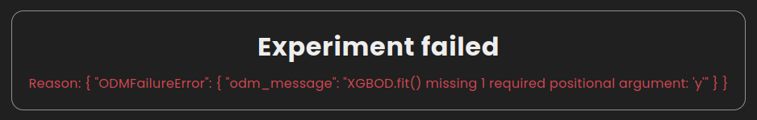
Unfixed Supervised ODMs
Supervised methods are available in the app but always fail
(XGBOD is semi-supervised)

Slide 18
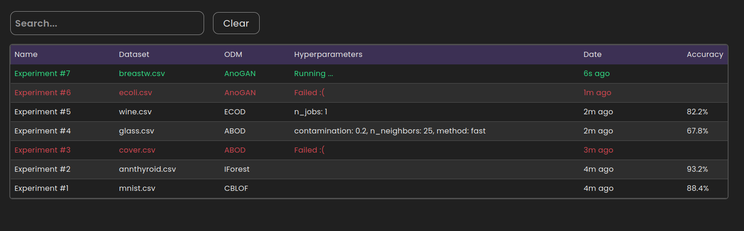
Improved Date on Dashboard
Creation Date
Presentation as [time] ago
=> all experiments are sorted by their creation date as default

Slide 19
Experiment Counting

Slide 20
Improved Sorting on Dashboard
Cell contains Tuple
( [metaData] , [string representation] )
Rows are sorted by metadata of the collumn
example: dates are compared by their int values
cells display the string representation

Slide 21
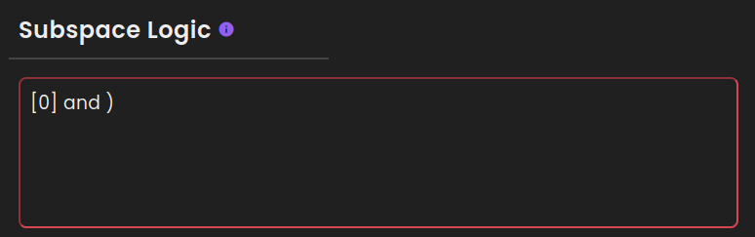
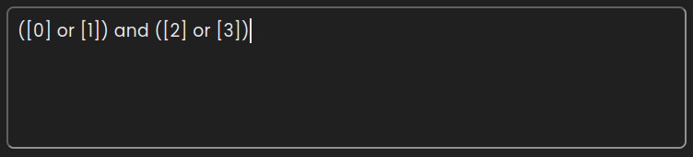
Improved Subspace Logic indicator
Instant feedback for incorrect/incomplete subspacelolgic

Slide 22
Thanks for your attention!
Bennet Hörmann, Salomo Hummel, Simeon Schrape, Erik Wu, Udo Zucker

